Slide 1


Child-Flourish
Integrated Learning, Emotional Intelligence Platform
Project ID : 24-25J-188

Slide 2
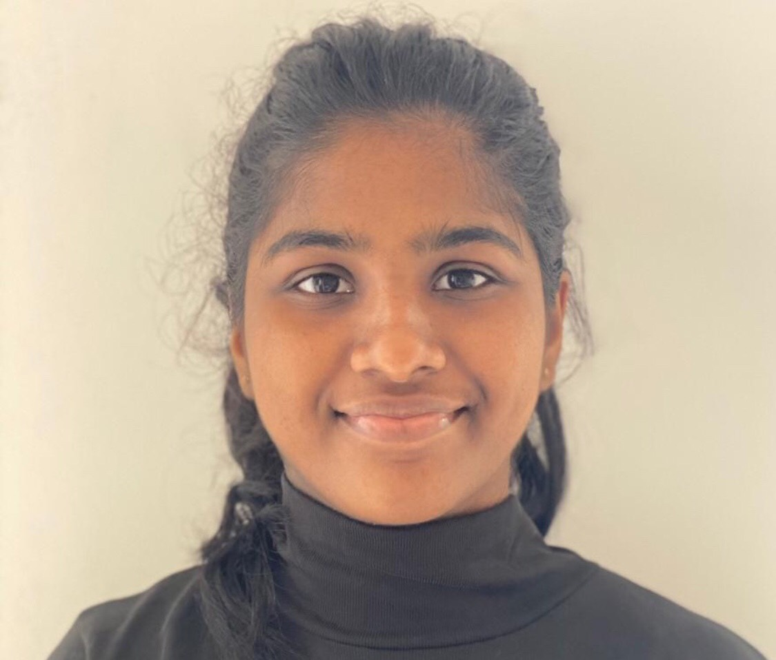


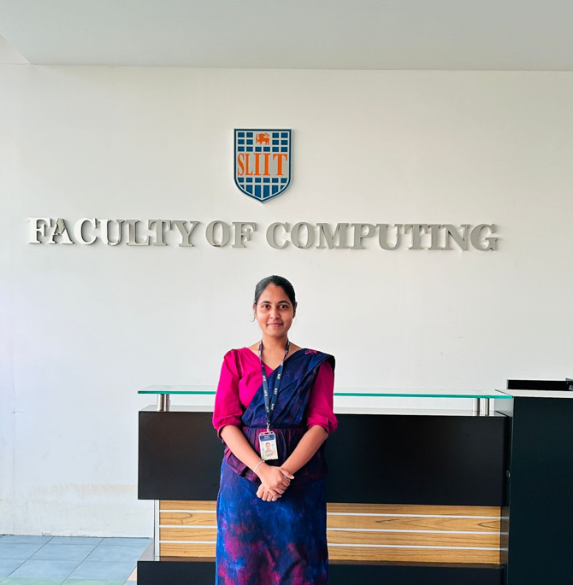

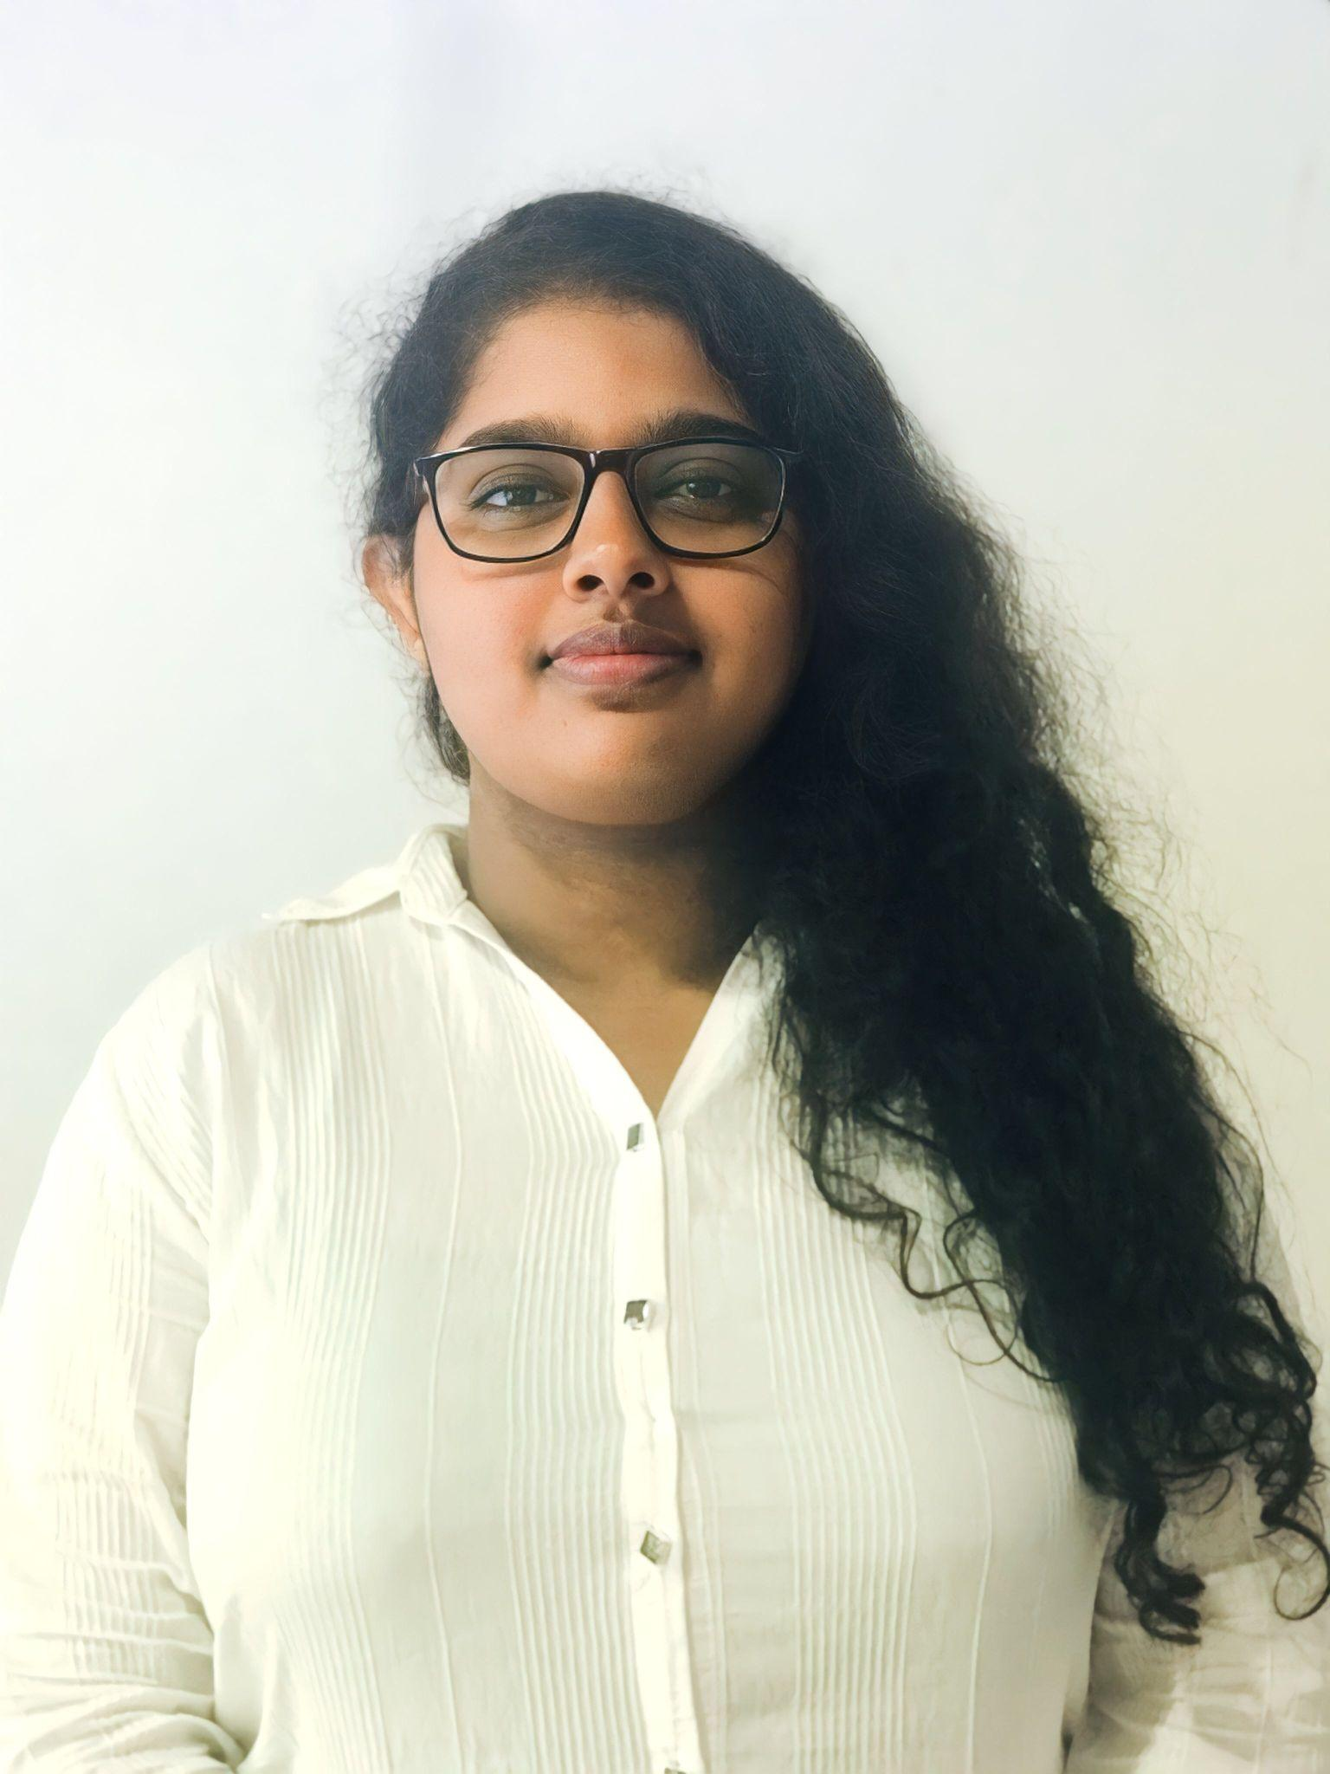
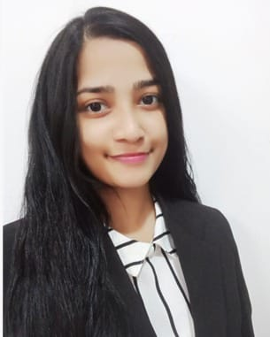
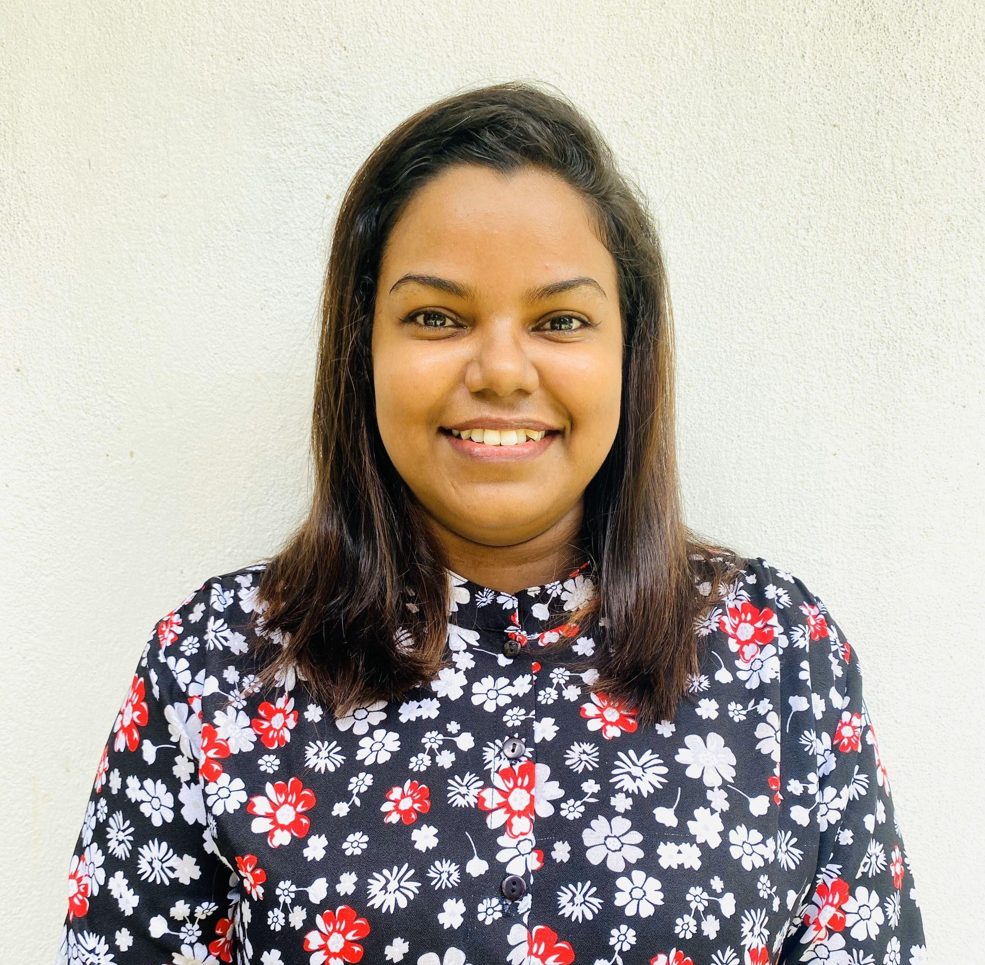

OUR TEAM
Our Team
Ms. Malithi Nawarathne
K.R.K Vidyaratna
IT21295706
LEADER
(+94) 772256676
it21295706@my.sliit.lk
Siriwardana K.D.S.P
IT21293894
(+94) 71 088 8133
it21293894@my.sliit.lk
Prof.Pradeep Abeygunawardhana
SUPERVISOR
Ms. Malithi Nawarathne
CO – SUPERVISOR
Dr.Nilushi Weerapperuma
EXTERNAL SUPERVISOR
Prasadi P.G.K.R
IT21302626
(+94) 70 594 5095
it21302626@my.sliit.lk
Dulangi G.K.N
IT21277290
(+94) 77 0431140
it21277290@my.sliit.lk

Slide 3

Background
In Sri Lanka, parents face difficulties balancing work responsibilities with the time required for their children’s early education and development.
The need for improved methods to identify and support children with Autism Spectrum Disorder (ASD) and ADHD.
There is a growing recognition of the need for innovative educational tools that enhance literacy and cognitive development.
Sri Lankan parents would benefit from flexible, adaptive educational solutions that address both developmental and educational needs.

Slide 4
Research Problem
Parents often struggle to balance work with their children's early education and development, especially for kids aged 5 to 10, a crucial period for social, emotional, and cognitive growth.

Slide 5
Objectives
Main Objective:
Develop an integrated learning platform to enhance cognitive and emotional development in young children and support parents.
Sub Objectives:
Automated Educational Assessment: Assess children's understanding through auto generated questions from educational content.
Early Identification of ADHD:
Predict ADHD in children using behavioral and cognitive indicators with machine learning.
Emotional Analysis:
Analyze children's facial expressions to identify emotional development issues.
Enhancing Literacy Skills:
Improve literacy through an educational game providing real-time feedback.
Screen Time Management:
Balance engagement and health by adhering to recommended screen time guidelines.

Slide 6
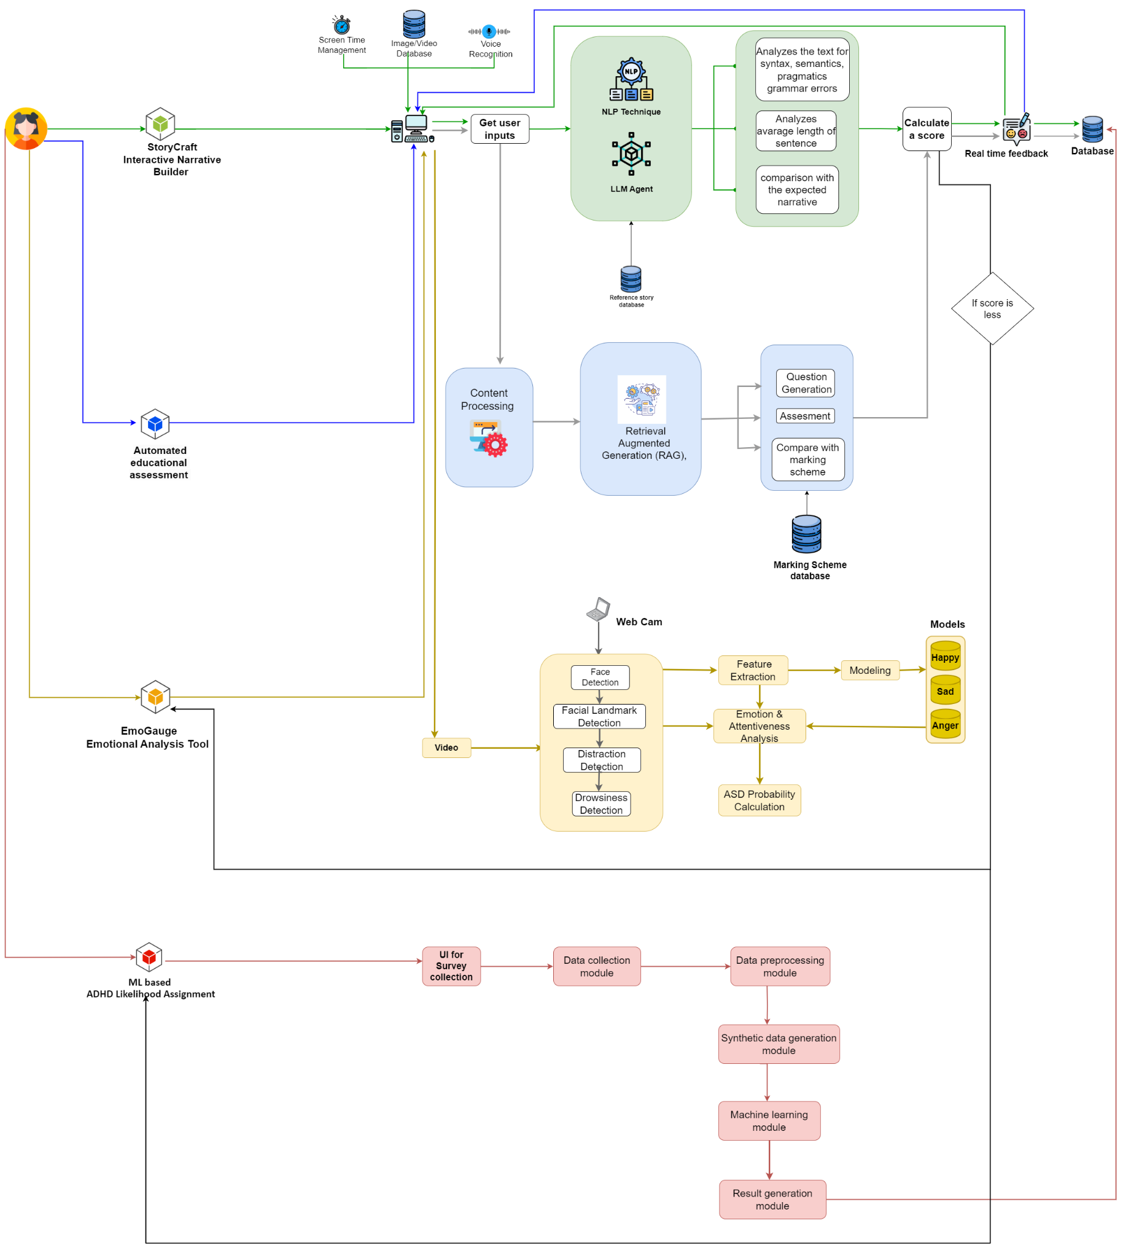
System Overview

Slide 7
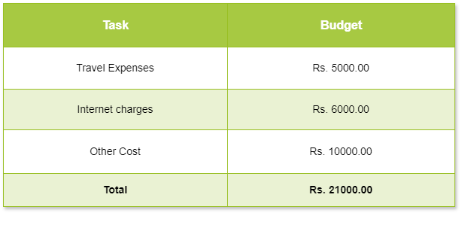
Budget Plan

Slide 8
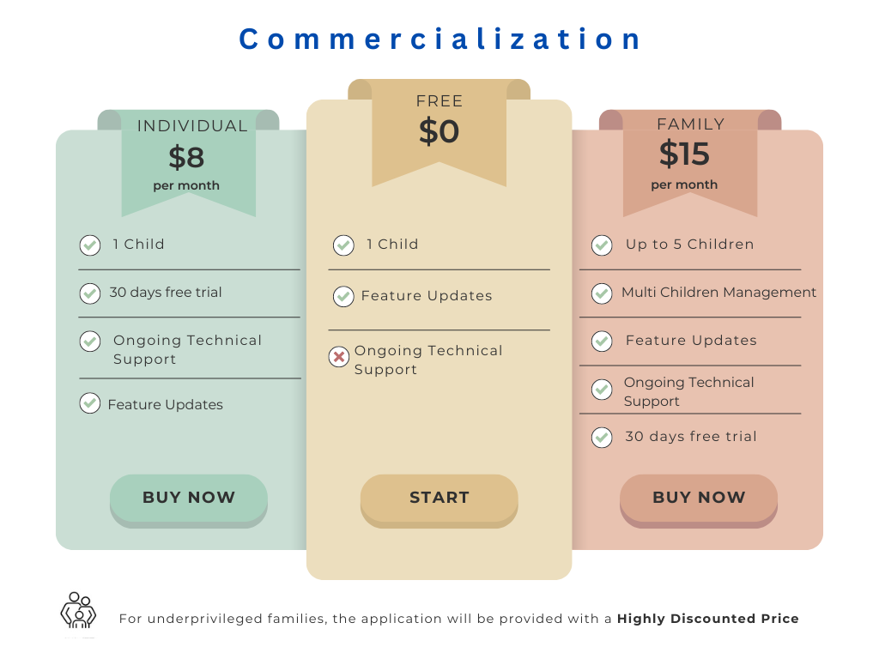

Slide 9

Individual Components

Slide 10
Component 1
ML based ADHD Likelihood Assignment
IT21295706
K.R.K Vidyaratna
Information Technology
IT21295706 | Vidyaratna K.R.K | 24-25J-188

Slide 11

Background
Early detection of ADHD in children is crucial for timely intervention
Traditional diagnosis methods are time-consuming and often subjective.
Goal is to utilize machine learning to predict the likelihood of ADHD based on behavioral data.
IT21295706 | Vidyaratna K.R.K | 24-25J-188

Slide 12
Research Gap
Features | A Gamified Learning Tool for Sri Lankan Primary Schools [1] | Applying machine learning to optimize the predictive model [2] | Child-Flourish
Data Collection: Comprehensive surveys for parents to gather relevant behavioral data | X | X | ✔
Early Detection: Identifies children at risk of ADHD early by analyzing behavioral data. | ✔ | ✔ | ✔
Personalized Inputs: Allow parents to provide additional textual descriptions of the child's behavior, if received score is lower | X | X | ✔
Model Development: Machine learning models trained on prepared datasets to predict ADHD likelihood. | X | ✔ | ✔
Novelty
Innovative Data Augmentation
Holistic Assessment Approach
Enhanced Accuracy
IT21295706 | Vidyaratna K.R.K | 24-25J-188
|

Slide 13

Research Questions
How can machine learning improve the accuracy of ADHD likelihood prediction?
What are the most indicative behavioral patterns for ADHD in children?
How effective is synthetic data in enhancing the prediction model's accuracy?
IT21295706 | Vidyaratna K.R.K | 24-25J-188

Slide 14

Objectives
Main Objective
Develop a machine learning model to predict ADHD likelihood based on behavioral data.
Sub Objective
Design a comprehensive survey for data collection from parents.
Integrate Synthetic Data Generation.
Evaluate and Refine the Machine Learning Model.
|
IT21295706 | Vidyaratna K.R.K | 24-25J-188

Slide 15
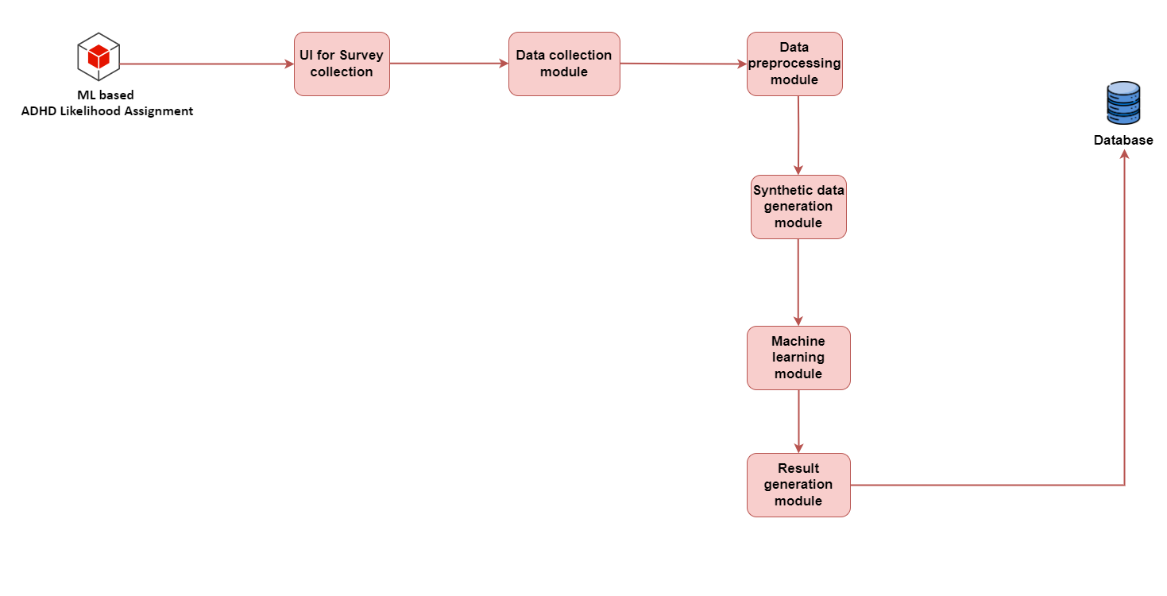
System Diagram
IT21295706 | Vidyaratna K.R.K | 24-25J-188

Slide 16







Technologies
React
MongoDB
Node JS
AWS / Azure
Firebase
Matplotlib
NumPy
|
IT21295706 | Vidyaratna K.R.K | 24-25J-188

Slide 17

Project Requirements
Functional requirements
Providing a user-friendly survey interface and additional text areas for parents to input behavioral data.
Generate synthetic data to augment the real dataset and improve model robustness.
Gather detailed insights into children's developmental milestones.
Provide a probability score for the likelihood of ADHD
Non-functional requirements
Performance
Accuracy
Usability
Data Security and Privacy
Scalability
Reliability
IT21295706 | Vidyaratna K.R.K | 24-25J-188

Slide 18
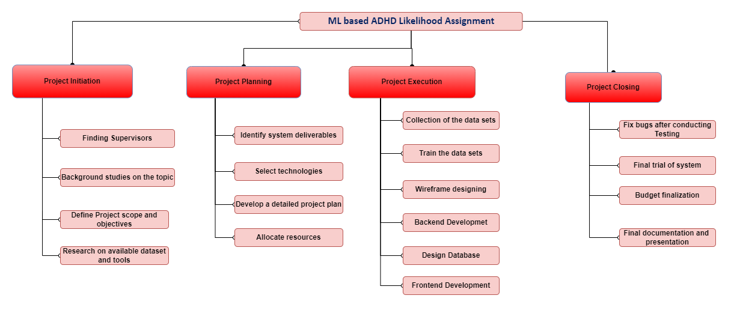
Work Breakdown Structure
IT21295706 | Vidyaratna K.R.K | 24-25J-188

Slide 19
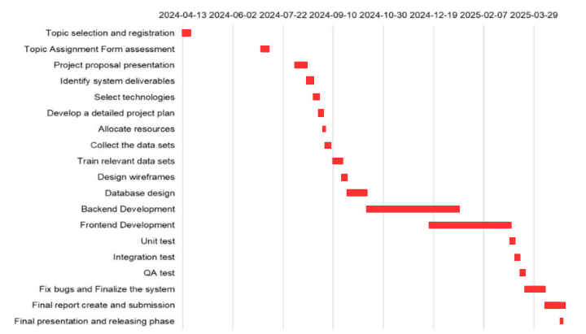
Gantt Chart
IT21295706 | Vidyaratna K.R.K | 24-25J-188

Slide 20


References
[1] R.A.G.K. Ranathunga, L.A.V.N. Rajakaruna, S.A.T.N. Karunarathne, L.N.Y. Abeywardena, D.P. Nawinna, and T. Halloluwa, "A Gamified Learning Tool for Sri Lankan Primary Schools," in 2014 IEEE International Conference on Engineering, Technology and Education (TALE), Sri Lanka, Jan. 2014.
[2] L. Q. Shao, J. You, Y. C. Cheung, Y. Huang, and Q. Shen, "ADHD classification by a computerized sustained attention test: Applying machine learning to optimize the predictive model," in Proc. IEEE Int. Conf. on Bioinformatics and Biomedicine (BIBM), Dec. 2019, pp. 912-919. doi: 10.1109/BIBM47256.2019.8983177.
IT21295706 | Vidyaratna K.R.K | 24-25J-188
21

Slide 21
Component 2
Emotional Analysis Tool (EmoGauge)
IT21293894
Siriwardana K.D.S.P
Information Technology
IT21293894 | Siriwardana K.D.S.P | 24-25J-188

Slide 22
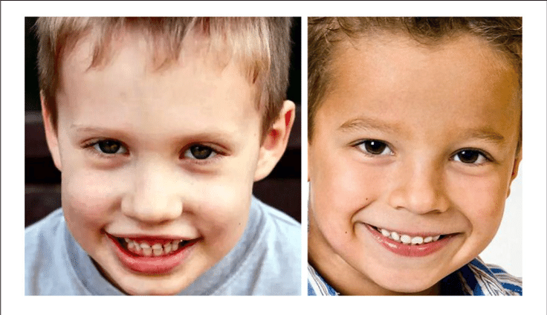
Background
ASD is increasingly recognized in Sri Lanka, with a rising number of diagnoses among children.
Emotion detection in real-time can provide valuable insights into children's emotional states and developmental issues.
It is important for parents to become aware of their child's condition early on.
IT21293894 | Siriwardana K.D.S.P | 24-25J-188

Slide 23
Research Gap
Features | Quantifying facial expression - related children with ASD [3] | Facial emotion recognition children with ASD [4] | Child-Flourish
Provides real-time tracking of children's facial expressions to determine their emotional states. | X | X | ✔
Mechanisms to measure children's attentiveness through video monitoring | X | X | ✔
Tracks and evaluates children's facial expressions to determine their emotional states. | ✔ | ✔ | ✔
Uses scenarios and contexts to evaluate children's facial expressions and emotional responses | X | ✔ | ✔
Novelty
Real-Time Emotional Analysis
Detection of emotion developmental issues.
Measurement of Attentiveness.
|
IT21293894 | Siriwardana K.D.S.P | 24-25J-188

Slide 24
Research Questions
How can we overcome the difficulty in early identification of Autism Spectrum Disorder (ASD) in children?
What are the challenges in effectively measuring and monitoring children's attentiveness?
How can we gather comprehensive data from parents regarding children's developmental milestones?
IT21293894 | Siriwardana K.D.S.P | 24-25J-188

Slide 25
Objectives
Main Objective
Early detection and intervention of Autism Spectrum Disorder (ASD), by analyzing children's facial expressions and attentiveness.
Sub Objective
Real-time Emotional Analysis.
Attentiveness Measurement.
Comprehensive Parental Questionnaires.
ASD Risk Probability Assessment.
Enhanced Diagnostic Support.
|
IT21293894 | Siriwardana K.D.S.P | 24-25J-188

Slide 26
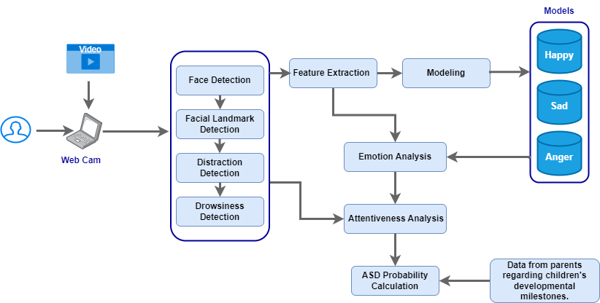
System Diagram
IT21293894 | Siriwardana K.D.S.P | 24-25J-188

Slide 27





Technologies
React
MongoDB
Node JS
Python
TensorFlow
Flask
OpenCV
|
IT21293894 | Siriwardana K.D.S.P | 24-25J-188

Slide 28
Project Requirements
Functional requirements
Track and evaluate children's facial expressions.
Identify potential emotional development issue.
Monitor children's attentiveness and engagement.
Gather detailed insights into children's developmental milestones.
Provide a probability score for the likelihood of autism spectrum disorder (ASD)
Non-functional requirements
Performance
Accuracy
Usability
Data Security and Privacy
Scalability
Reliability
IT21293894 | Siriwardana K.D.S.P | 24-25J-188

Slide 29
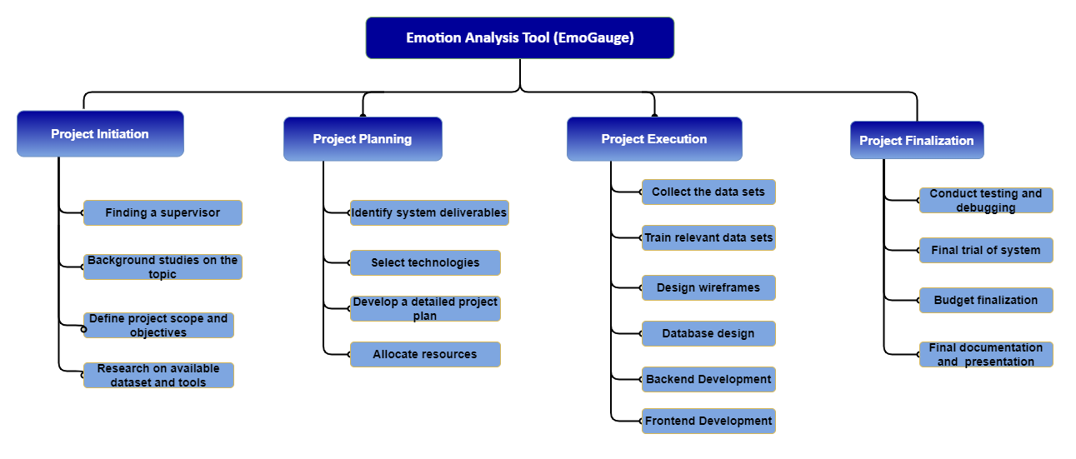
Work Breakdown Structure
IT21293894 | Siriwardana K.D.S.P | 24-25J-188

Slide 30
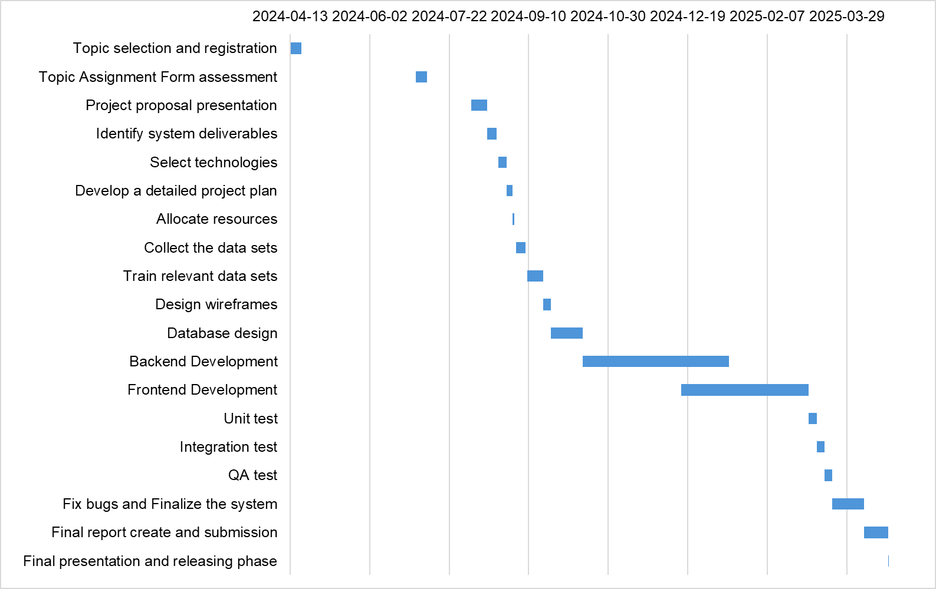
Gantt Chart
IT21293894 | Siriwardana K.D.S.P | 24-25J-188

Slide 31
References
[3] T. Guha, Z. Yang, A. Ramakrishna, R. B. Grossman, D. Hedley, S. Lee, and S. S. Narayanan, "On quantifying facial expression-related atypicality of children with autism spectrum disorder," in Proc. 2nd Int. Conf. Remote Sensing, Environment and Transportation Engineering, 19-24 April 2015.
[4] E. Nagy, L. Prentice, and T. Wakeling, "Atypical facial emotion recognition in children with autism spectrum disorders: Exploratory analysis on the role of task demands," Psychology, School of Social Sciences, The University of Dundee, UK.
IT21293894 | Siriwardana K.D.S.P | 24-25J-188

Slide 32
Component 3
Interactive Narrative Builder (StoryCraft)
IT21302626
Prasadi P.G.K.R
Information Technology
IT21302626 | Prasadi P.G.K.R | 24-25J-188

Slide 33
Background
Parental Concern for Cognitive and Language Development
Need for Innovative Cognitive Skills Assessment
Importance of Screen Time Management
IT21302626 | Prasadi P.G.K.R | 24-25J-188

Slide 34
Research Gap
Features | Storytelling system for school-age children [5] | Gesture and Voice Recognition in Storytelling Application [6] | Child-Flourish
Allows children to narrate stories verbally, converting speech to text for analysis. | X | ✔ | ✔
Immediate correction and scoring of syntax, semantics, pragmatic grammar errors and provides detailed feedback | X | X | ✔
Unique feature to compare the child’s story with a reference story to check coherence and accuracy | ✔ | ✔ | ✔
Built in screen time management to promote healthy usage habits. | X | X | ✔
Novelty
Voice Recognition for Storytelling.
Real-Time Feedback.
Narrative Alignment.
Screen Time Enforcement
|
IT21302626 | Prasadi P.G.K.R | 24-25J-188

Slide 35
Research Questions
How can we effectively measure a child's cognitive development through storytelling?
What methods can be used to evaluate a child's creativity in narrative construction?
How do children interpret images and construct stories differently?
How can we identify a child's strengths and weaknesses in language and cognitive skills?
IT21302626 | Prasadi P.G.K.R | 24-25J-188

Slide 36
Objectives
Main Objective
Enhance Children's Cognitive and Language Development.
Sub Objective
Develop Interactive Storytelling Prompts.
Implement Real-Time Feedback Mechanism.
Integrate Voice Recognition Technology.
Design Adaptive Difficulty Levels.
Include Screen Time Management.
|
IT21302626 | Prasadi P.G.K.R | 24-25J-188

Slide 37
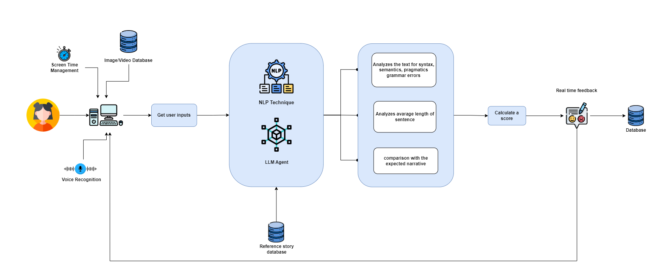
System Diagram
IT21302626 | Prasadi P.G.K.R | 24-25J-188

Slide 38




Technologies
React
MongoDB
Node JS
Python
Flask
Google Cloud Speech-to-Text API
NLTK
Open AI
|
IT21302626 | Prasadi P.G.K.R | 24-25J-188

Slide 39
Project Requirements
Functional requirements
Provide diverse storytelling prompts (images/videos).
Capture and convert spoken stories using voice recognition.
Analyze text for syntax, semantics, and pragmatics.
Offer real-time feedback on narrative structure.
Implement screen time management with automatic session end.
Non-functional requirements
Availability.
Reliability
Speed
Performance
Security
Privacy
IT21302626 | Prasadi P.G.K.R | 24-25J-188

Slide 40
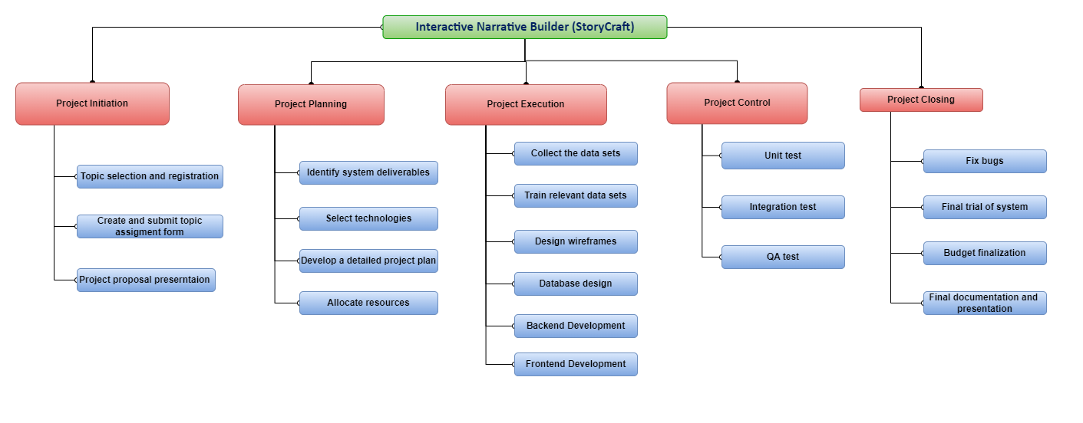
Work Breakdown Structure
IT21302626 | Prasadi P.G.K.R | 24-25J-188

Slide 41
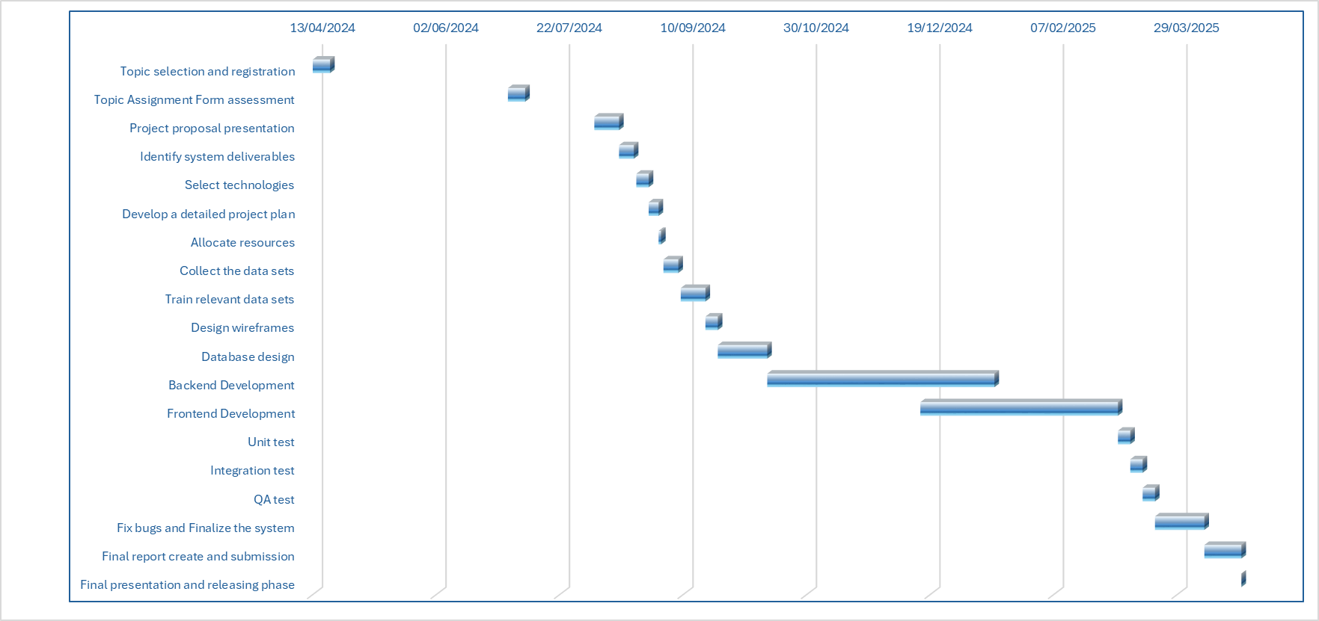
Gantt Chart
IT21302626 | Prasadi P.G.K.R | 24-25J-188

Slide 42
References
[5] P.-F. Wu, Y.-T. Liao, and K.-Y. Fan, "Developing and assessing the usability of digital manipulative storytelling system for school-age children," in Proc. IEEE Conf. e-Learning and e-Teaching, 2016, pp. 465-468.
[6] A. Kanawade, S. Varvadekar, D. R. Kalbande, and P. Desai, "Gesture and Voice Recognition in Storytelling Application," in Proc. 2nd International Conference on Inventive Systems and Control (ICISC), 2018, pp. 1-5.
IT21302626 | Prasadi P.G.K.R | 24-25J-188

Slide 43
Component 4
Automated Educational Assessment System for Cognitive Development
IT21277290
Dulangi G.K.N
Information Technology
IT21277290 | Dulangi G.K.N | 24-25J-188

Slide 44
Background
Current Educational Challenges
Advancements in Educational Technology
Need for Personalized Learning
Importance of Immediate Feedback
IT21277290 | Dulangi G.K.N | 24-25J-188

Slide 45
Research Gap
Features | Implementation and assessment of the automatic question generation module | A Question Generation Engine for Educational Assesment Based on Domain Ontologies | Child-Flourish
generates personalized questions tailored to each child's individual learning needs, ensuring a unique and customized assessment experience. | X | X | ✔
Incorporates Retrieval Augmented Generation (RAG) for personalized question generation. | X | X | ✔
Automatically generate relevant and challenging questions, adapting to the child's progress and learning level. | ✔ | ✔ | ✔
Calculate a score and Real time feedback | X | X | ✔
Novelty
Retrieval Augmented Generation (RAG)
Pre-trained Large Language Model
Dynamic Question Variation
Comprehensive and Fair Assessment
IT21277290 | Dulangi G.K.N | 24-25J-188

Slide 46
Research Questions
Immediate Feedback Impact
Multimodal Content Integration Enhancing Cognitive Development
Generating Meaningful Educational Content
Leveraging AI
IT21277290 | Dulangi G.K.N | 24-25J-188

Slide 47
Objectives
Main Objective
To develop an automated educational assessment system that enhances children's cognitive development by providing personalized, immediate feedback on their understanding of various study materials.
Sub Objective
To enable children to upload diverse types of educational content for assessment.
To utilize advanced AI technologies (RAG, LLM) to generate and evaluate questions.
To provide immediate feedback and scoring to aid in children's learning processes.
To integrate multimodal content to improve assessment accuracy and engagement.
IT21277290 | Dulangi G.K.N | 24-25J-188

Slide 48
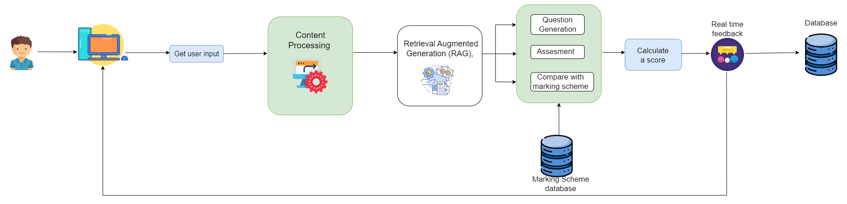
System Diagram
IT21277290 | Dulangi G.K.N | 24-25J-188

Slide 49


Technologies
Python
TensorFlow
React
MongoDB
Node JS
Flask
IT21277290 | Dulangi G.K.N | 24-25J-188

Slide 50
Requirement Analysis
Functional requirements
Allow users to upload various types of study materials.
Analyze the uploaded content and generate relevant questions
Evaluate answers and provide immediate feedback and scores.
Store user data securely for future reference and analysis.
Non-functional requirements
Accuracy
Reliability
Performance
Scalability
Usability
IT21277290 | Dulangi G.K.N | 24-25J-188

Slide 51
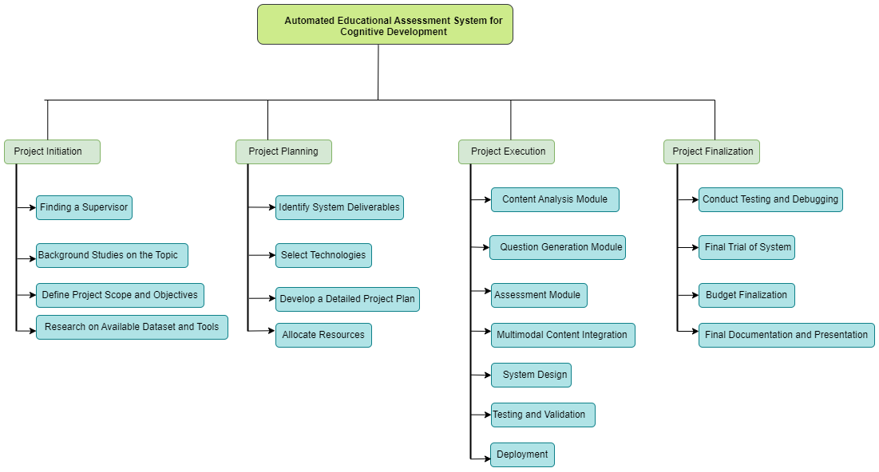
Work Breakdown Structure
IT21277290 | Dulangi G.K.N | 24-25J-188

Slide 52
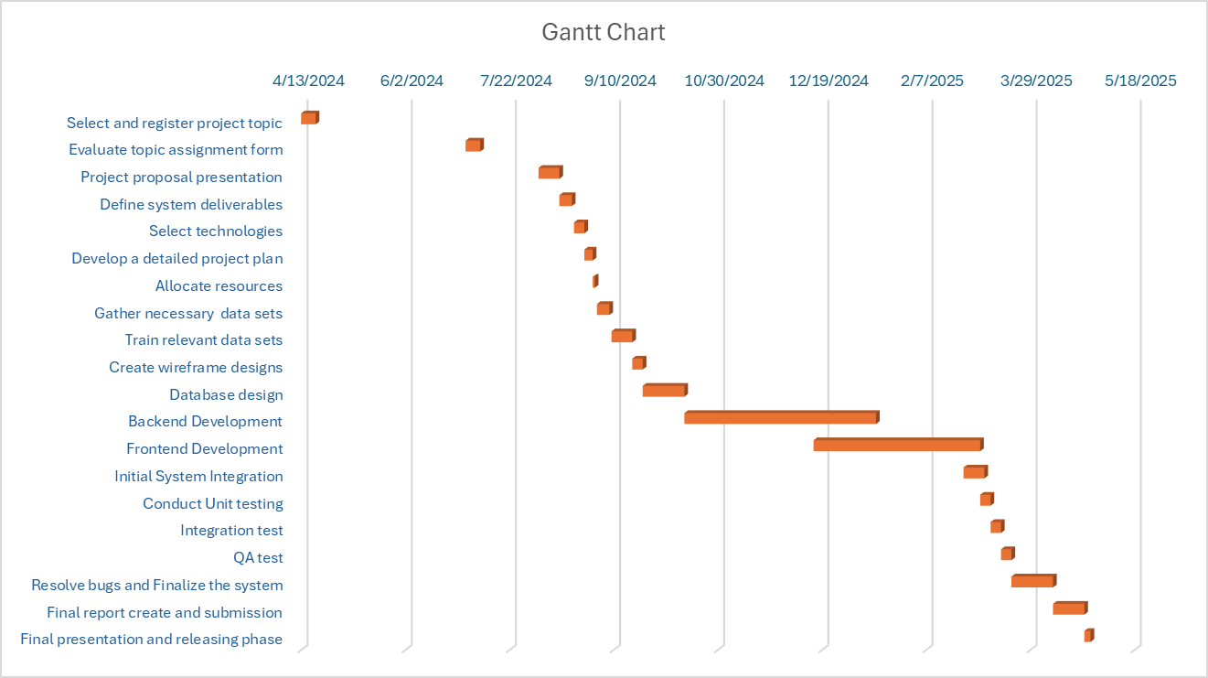
Gantt Chart
IT21277290 | Dulangi G.K.N | 24-25J-188

Slide 53
References
[7] L. Bednarik and L. Kovács, "Implementation and assessment of the automatic question generation
module," in 2012 IEEE 3rd International Conference on Cognitive Infocommunications (CogInfoCom),
Kosice, Slovakia, 2012, pp. 687-690, doi: 10.1109/CogInfoCom.2012.6421938 [8] M. Al-Yahya, "OntoQue: A Question Generation Engine for Educational Assessment Based on Domain Ontologies," in 2011 IEEE 11th International Conference on Advanced Learning Technologies, Athens, GA, USA, 2011, pp. 393-395, doi: 10.1109/ICALT.2011.124. Keywords: Ontologies; Engines; Semantics; OWL; Resource description framework; Conferences; Assessment; Domain Ontology; Question Generation.
IT21277290 | Dulangi G.K.N | 24-25J-188
07/08/2024

Slide 54


Q&A SESSION

Slide 55


THANK YOU!

